Slide 1
Puppet VSCode Extension
James Pogran
Senior Software Engineer - Windows Puppet
Notes:
Hello everyone, I’m James Pogran and I work on the Windows team here at Puppet
And today I’m going to talk to you about the new official Puppet VSCode extension

Slide 2
Agenda
What is it?
Who wrote it?
What is in it?
Demo!
Notes:
Today we’ll cover a short overview of the extension and then demo a few features

Slide 3
What is it?
Notes:
What is it? (next slide)

Slide 4
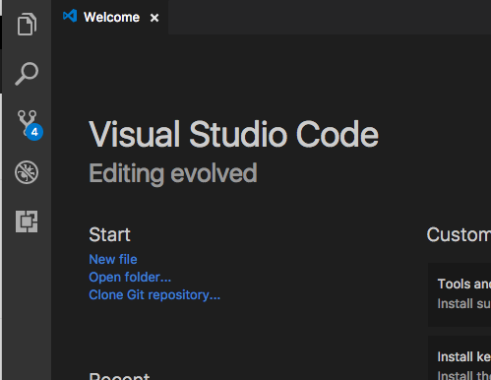
Visual Studio Code
One editor please
https://code.visualstudio.com
Light-weight streamlined code editor
Cross platform (Windows, Mac, Linux)
Extendable
Notes:
VSCode is a lightweight editor that works cross platform
It provides a nice default editing experience, and allows a great deal of customization
One aspect of that customization that is important today is extensions, namely ours

Slide 5
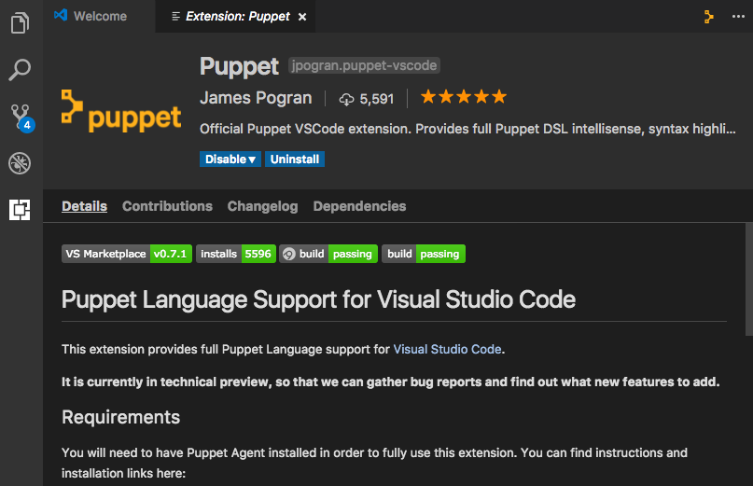
Puppet VS Code Extension
It’s alive!
VS Marketplace: puppet-vscode
Over 5,000 installs
0.7.1 latest version
Open source
Notes:
Our VSCode extension has been out for a few months now, and has over 5,000 installs.
We’re on version 0.7.1, working on the list of things for 0.8 now
We’re developing it open source, so check out our project on Github. Link is at the end of the presentation

Slide 6
Who wrote it?

Slide 7
Puppet VS Code Extension
Authors
James Pogran
Senior Software Engineer, Puppet
https://github.com/jpogran
@ender2025
http://jamespogran.com
Notes:
I started out the extension way back when wrapping puppet commands and with basic syntax and grammar. I worked with Glenn Sarti to get the extension to where it is today

Slide 8
Puppet VS Code Extension
Authors
Glenn Sarti
Senior Software Engineer, Puppet
https://github.com/glennsarti
@glennsarti
https://glennsarti.github.io
Notes:
Glenn has pioneered the language server implementation of Puppet since the start, and continues to be a major contributor

Slide 9
Puppet VS Code Extension
Authors
Austin Blatt
Intern, Puppet
https://github.com/austb
Notes:
Austin worked on our extension as part of his summer internship at Puppet and contributed to the language server

Slide 10
What is in it

Slide 11
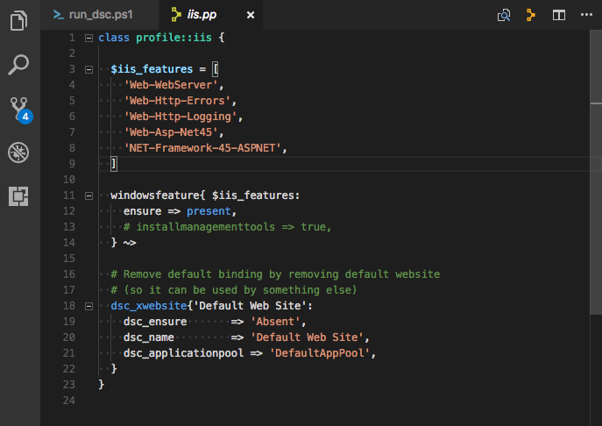
Puppet VS Code
Syntax highlighting
Notes:
Out of the box you’ll get all the syntax highlighting you’d expect from a Puppet editor, which changes along your color scheme

Slide 12
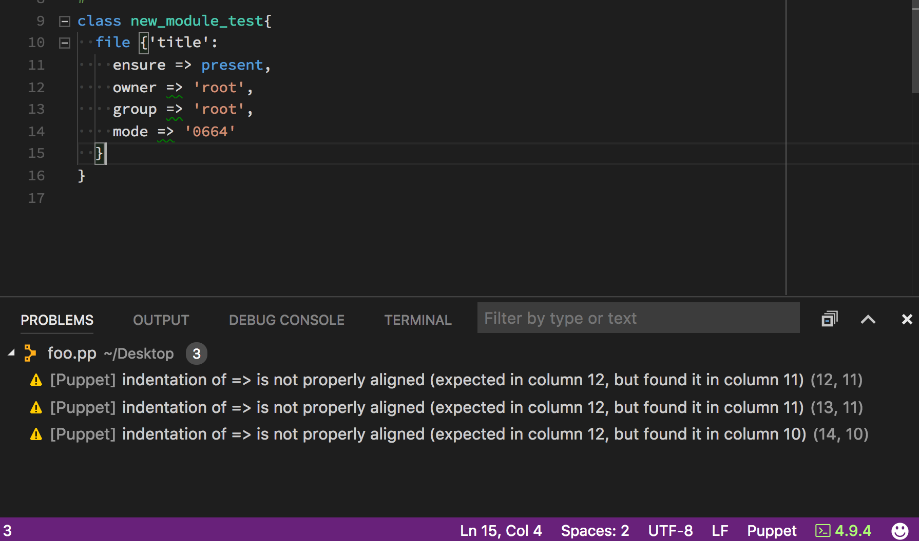
Puppet VS Code
Syntax validation
Notes:
Also built in is puppet-lint, which provides as-you-type validation. No need to save the file in order to get an indication if there is an error or warning.
It respects puppet-lint rc files, and inline ignore rules
All errors and warnings show up in the Problems pane as they occur, and are removed as they are fixed

Slide 13
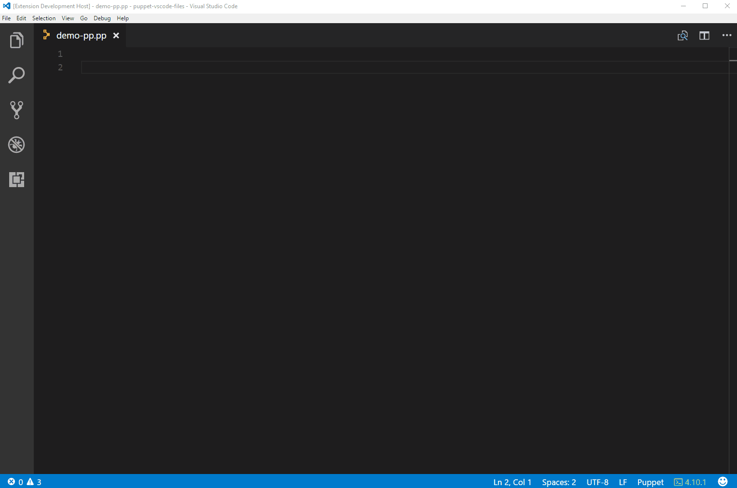
Puppet VS Code
Intellisense
Notes:
Intellisense provides auto completion of class, types and parameters as you type your code.
Notice we have available all the puppet resources and variables you have available to your agent install
Facts are resolved as you type, providing a list of available facts on your system

Slide 14
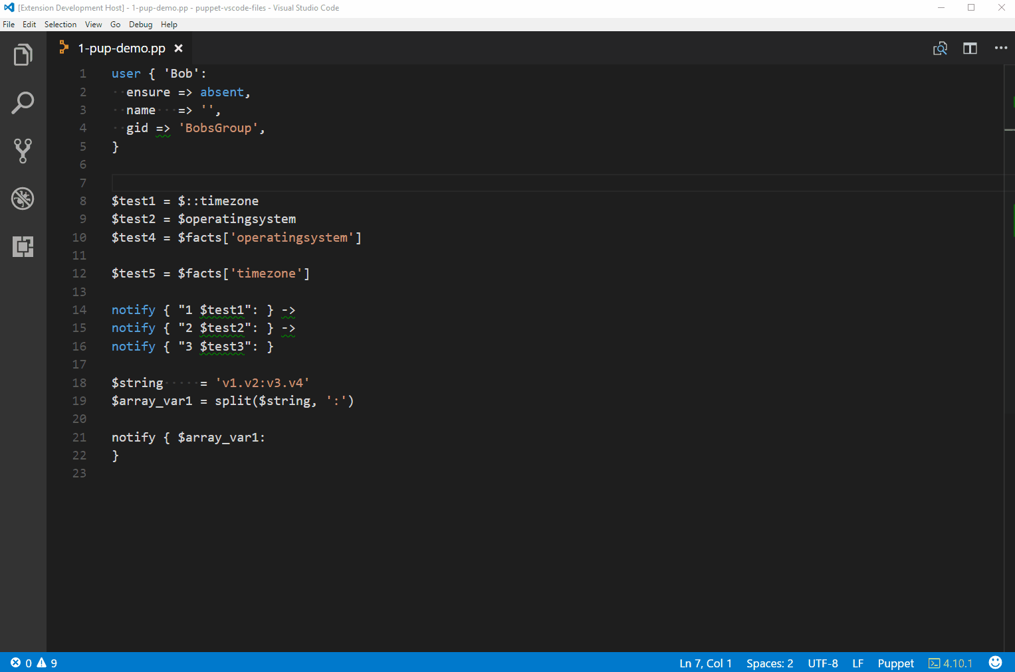
Puppet VS Code
Hover support
Notes:
Hover support provides inline help, and resolves the values from facts defined in the manifest
Inline popups shows class level documentation, as well as parameter help
Facts are resolved from the system your editor is running on, giving you instant feedback on whether your statement is correct or not
Function declarations are resolved, showing help and parameter syntax directly from the definition

Slide 15
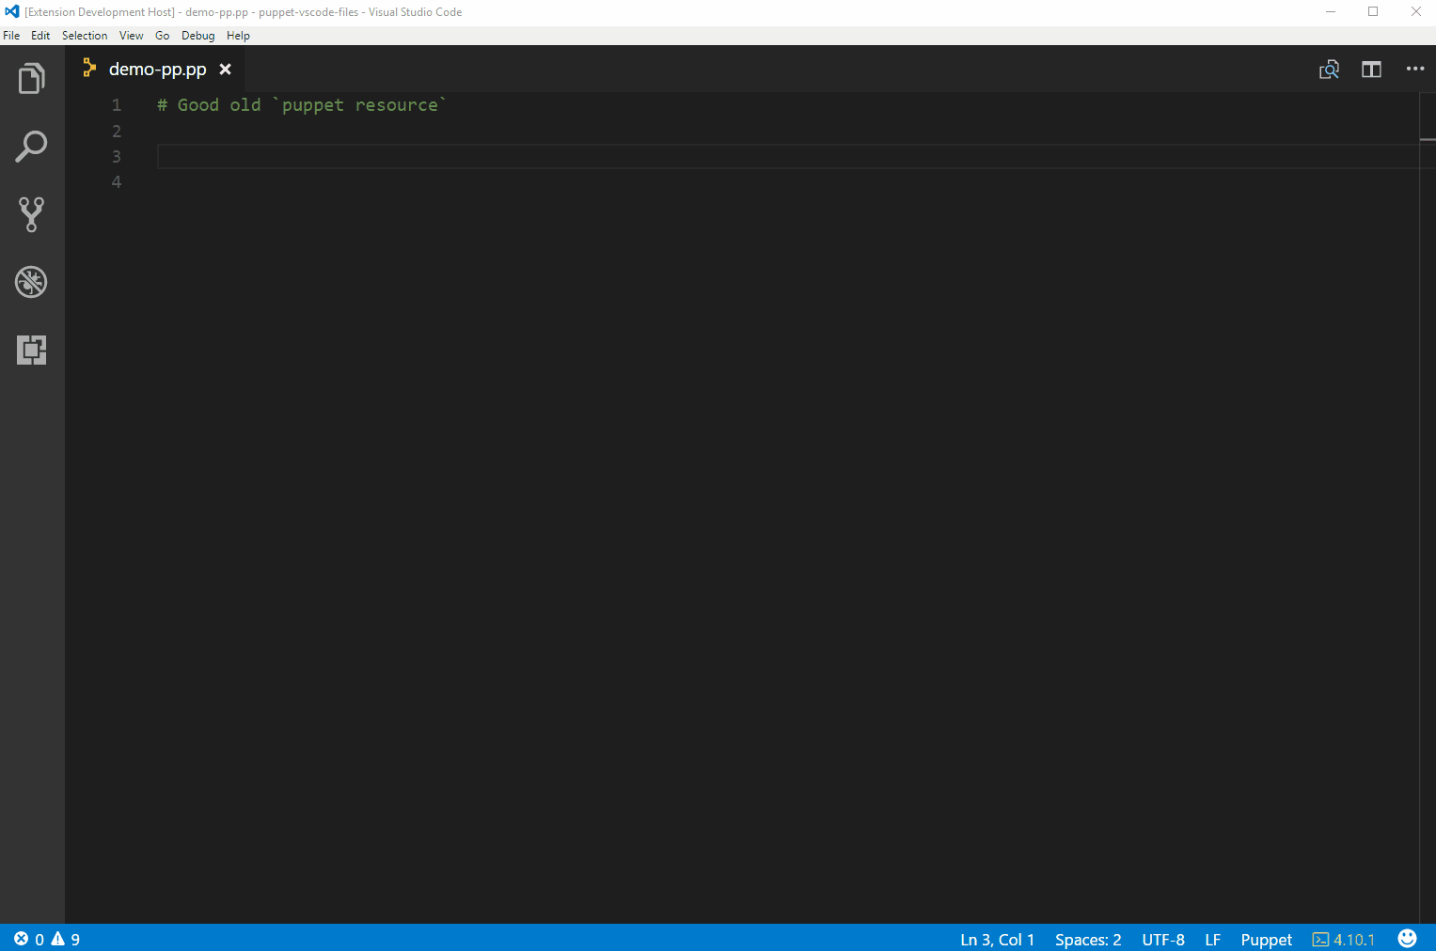
Puppet VS Code
Puppet Resource
Notes:
You can quickly get your new manifest started by using the puppet resource command in VSCode
To generate a listing of a particular module to get you started.
Then you can edit and customize to fit your deployment needs

Slide 16
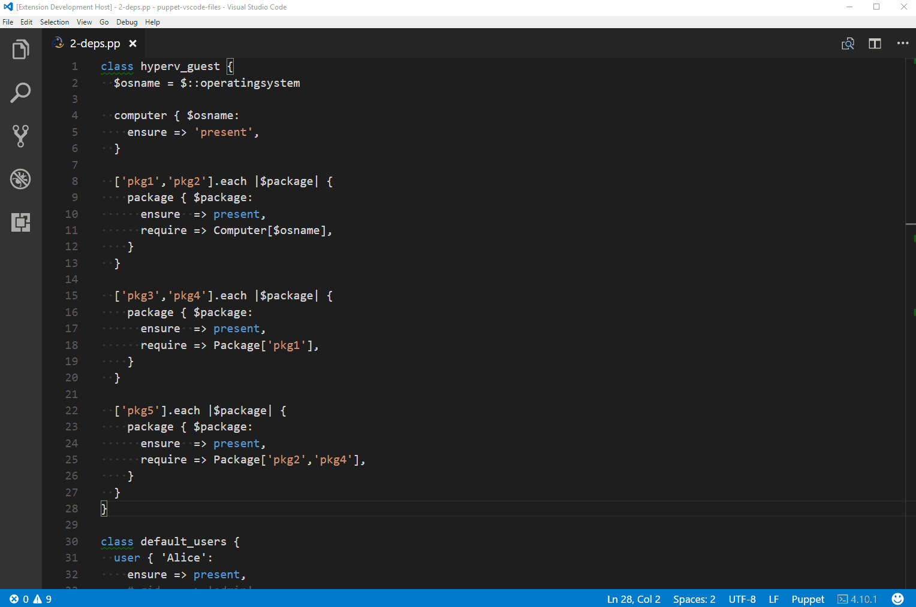
Puppet VS Code
Puppet Node Graph
Notes:
You can generate a visual representation of your node graph from your open manifest file

Slide 17
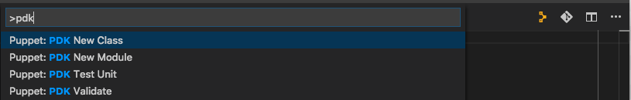
Puppet VS Code
Puppet Development Kit

Slide 18
Demo
But does it work?

Slide 19
Puppet VS Code Extension
We take Pull Requests!
We need your feedback!
https://github.com/jpogran/puppet-vscode/issues
https://github.com/jpogran/puppet-vscode/blob/master/client/CHANGELOG.md

Slide 20
Fin

